Slide 1



Erasmus+
Collaborative Partnerships
Finnish pilot project Valtti 2016 was a success
- finding a hobby with a personal APA instructor (PAPAI)
Aija Saari, research manager
aija.saari@vammaisurheilu.fi
13.8.2017

Slide 2
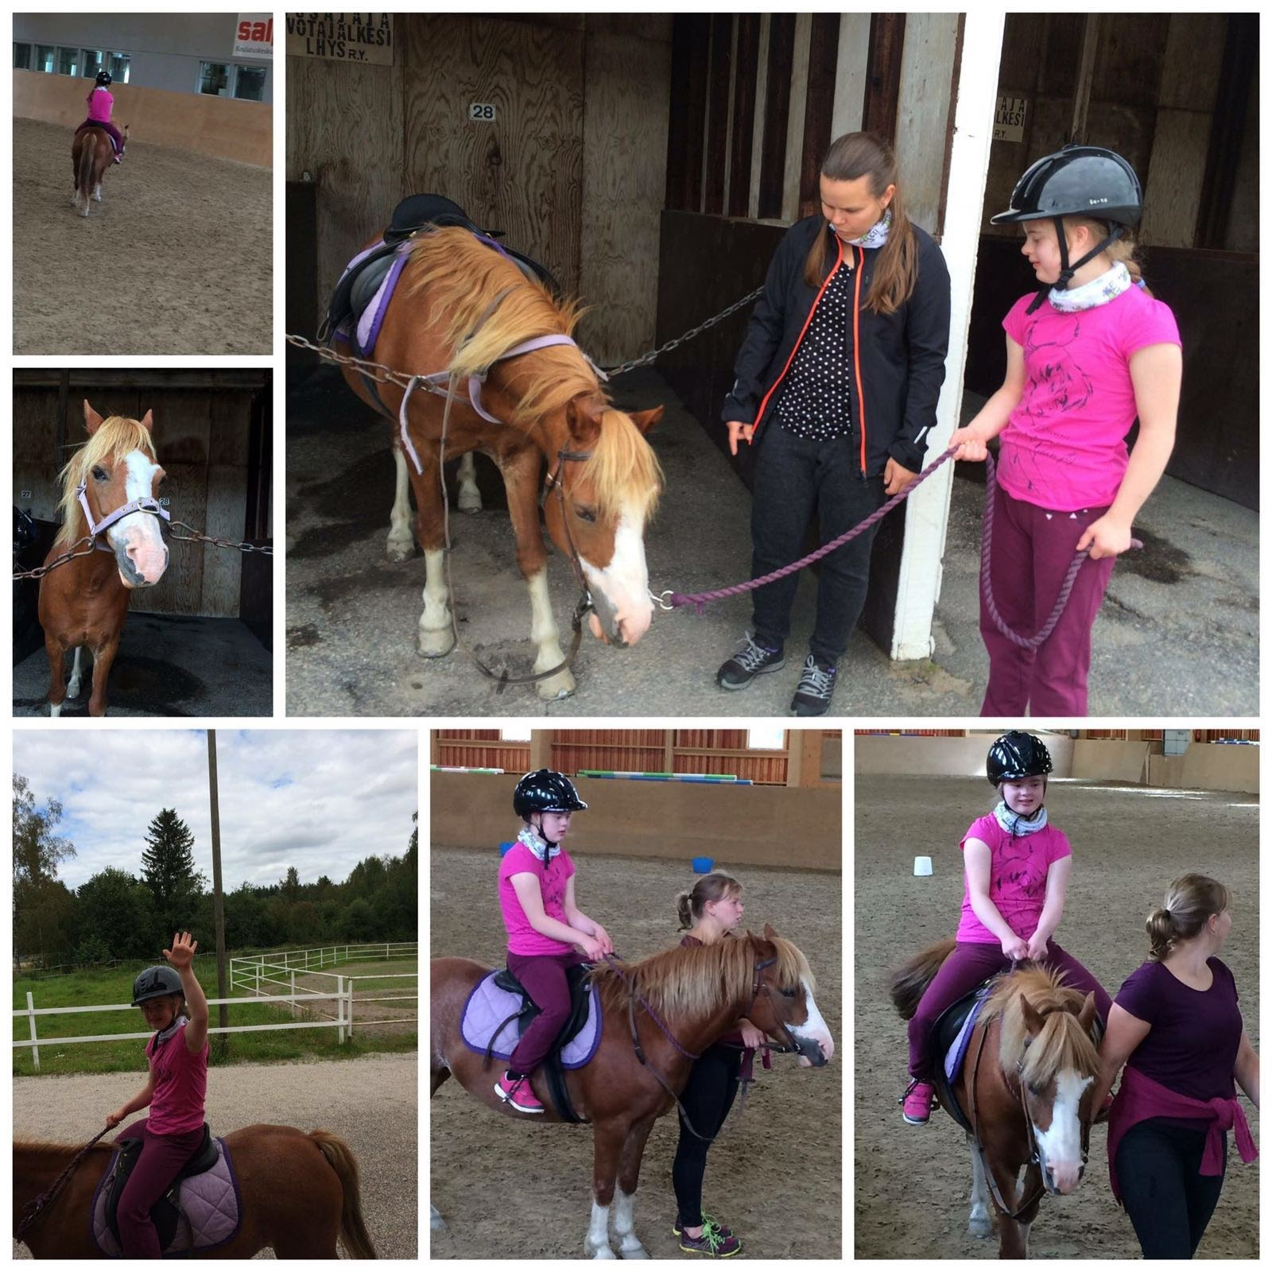
Overview
What is VAU and what is SEDY?
Valtti method and PAPAI in nutshell.
Valtti pilot participants and results.
Meet Ossi, Osku, Venla, Aaro, Vera and Elias!
Future of Valtti and PAPAI-method.

Slide 3
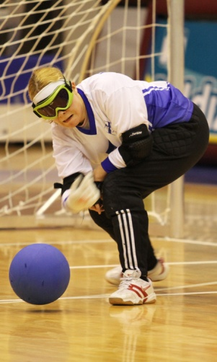
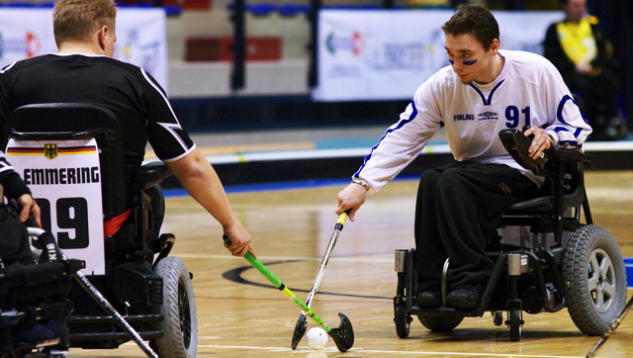
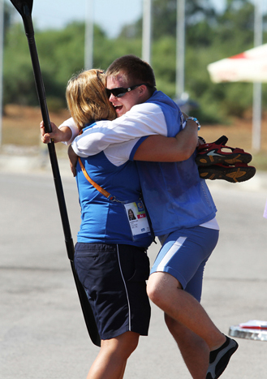
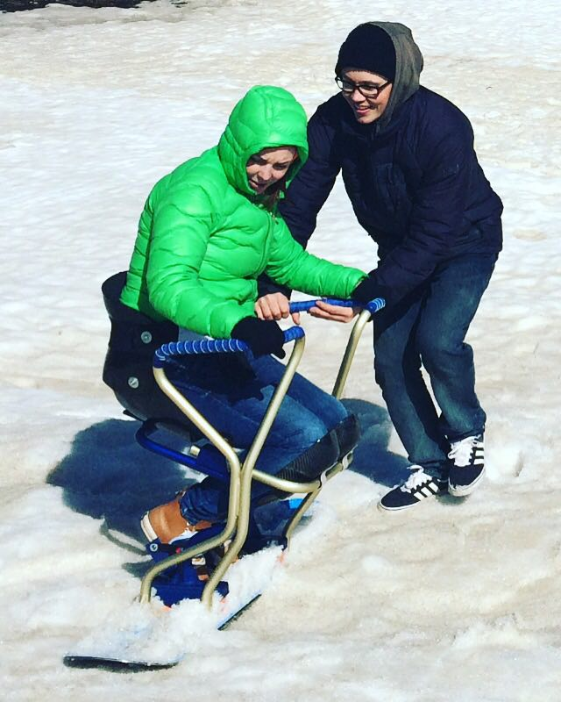
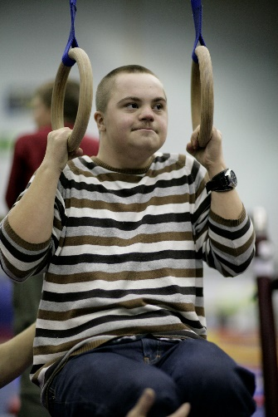
VAU is a Finnish umbrella for disability sports
VAU was born in 2009 when sports federations for persons with physical disabilities and intellectual disabilities, visual impairment & transplant recipients united.
VAU has 70.000 personal members in local disability clubs and sports clubs (∞ 200).
VAU is a coordinator of municipal APA-instructors’ network (∞ 100).
VAU is a member of Finnish Olympic and Paralympic Committees, and is also the Special Olympics Finland.
VAU seeks new ways to motivate persons with disabilities to become physically active.
www.vammaisurheilu.fi

Slide 4

SEDY-project is an Erasmus+ partnership
-Sport Empowers Disabled Youth 2015-2017 (SEDY) is coordinated by the Amsterdam University of Applied Sciences, Faculty of Sports and Nutrition, and InHolland University of Applied Sciences, the Netherlands.
- Aims to contribute to increase physical activity of children with a disability, especially through a better matching of the demand and the supply.
- The partners:
Youth Sport Trust, United Kingdom
WheelChair Dance Sport Association, United Kingdom
Finnish Sports Association of Persons with Disabilities (VAU), Finland
ENGSO Youth, Italy
Sport & Citizenship, France
Lithuanian Sports University, Lithuania
Sport Science School – Polytechnic Institute of Santarem, Portugal

Slide 5

SEDY-project, what and when?
2015
2016
2017
In the first year focus was on the inventory. What is the status of sports for children and youth with disabilities in SEDY-countries?
Dissemination & evaluation. What did we find and learn? Final conference 29.11.2017 Amsterdam.
http://www.hva.nl/kc-bsv/gedeelde-content/contentgroep/sedy-project/results/inventory-in-the-countries-involved-in-the-project/inventory-in-the-countries-involved-in-the-project.html
In the second year focus was on developing Valtti/PAPAI-pilot in Finland and YST Focus on me -pilot in UK.
http://www.hva.nl/kc-bsv/gedeelde-content/contentgroep/sedy-project/results/development-of-pilots/development-of-pilots.html
For more information see http://www.hva.nl/kc-bsv/gedeelde-content/contentgroep/sedy-project/sedy-project.html

Slide 6
The first year inventory results of the interviews and literature reviews have been combined in a factsheet per country:
SEDY-infosheet Finland: http://www.vammaisurheilu.fi/ajankohtaista/valtti/in-english

Slide 7





Finland invented and piloted the model of Valtti
http://www.vammaisurheilu.fi/ajankohtaista/valtti/in-english
Valtti (=PAPAI in english, personal adapted physical activity instructor)
to meet the gap between demand and supply of children and youth (age 6-23) with a disability and inclusive sports services.

Slide 8
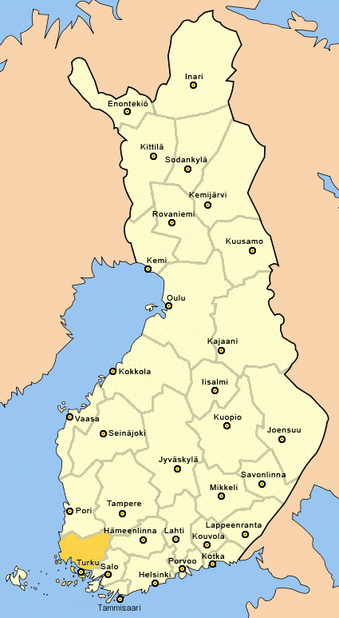
Valtti model was tested in the whole country
In key locations 15 experts or advanced students were hired as part-time PAPAIcoordinators to
help and coach the PAPAI,
keep time, approve try-out budgets, solve any problems between family, hobby and PAPAI,
network (marketing, information) between the institutes, municipalities, sports clubs, families & VAU,
after try-outs collect reports and photos, write PAPAI-diplomas.
In final conference: give feedback & development ideas.
in co-operation with 19 institutes or universities (schools).
The PAPAIs were students or
volunteers of health and social
care, sports of education.
335 students/volunteers sent their application to become a PAPAI.
22 training events for students
in 20 schools were organised.

Slide 9
PAPAI pilot in the nutshell
The Valtti method was tested in 15 biggest cities in 2016. The goal was to find a hobby for the child or youth with a disability with help of personal coach or buddy.
PAPAIs got study credits. They didn’t get fee, but their expences (travel etc.) were covered.
The online application process was open in spring 2016. Applicants and students were matched to make up Valtti pairs. Some applicants had two Valttis.
In autumn the PAPAI met the family, made an individual hobby try-out plan and acted as a sports buddy minimum 4 times. The try-outs were documented with photographs and hobby-try-out diaries.
Participation for the child was free of charge, except one’s insurance-, travel- and ticket costs.
In the end of the year an electronic questionnaire was sent to collect feedback.

Slide 10
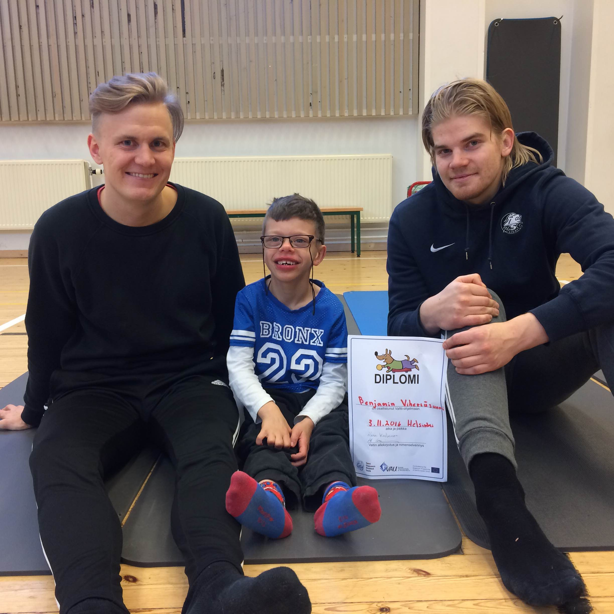
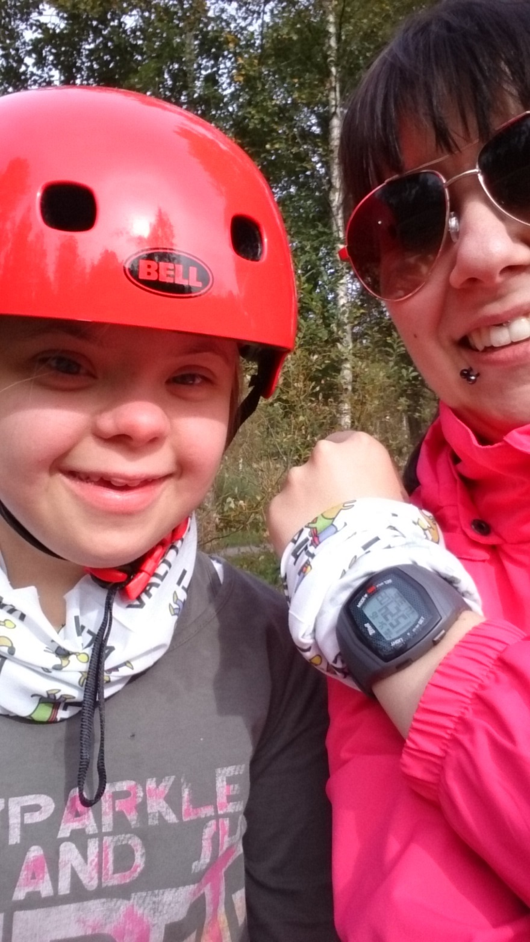

Slide 11
1. Online application – 2. consent information sheet & Valtti pairs
3. First contact and interview
4. Hobby-try-out-plan
5. Experimental period
6. Final meeting
Get to know each other, background, interests, resources, goals
Opportunities (special vs. mainstream).
Group vs. individual activities.
Min 4 (2) try-outs, feedback, photos.
Did we find a hobby? Did we meet the goals? Recommendations for the future.

Slide 12
Valtti pilot was a success
367 applicants by March 2016. 288 received a PAPAI. 16% (n=47) cancelled or dropped out due illness, moving to another city, finding a hobby or time problems.
237 children and youth finished the project (=did the experiments) and 155 of them took part in the feedback survey (Heidi Skantz/Jyväskylä University).
An electronic questionnaire was used to capture the participant’s sociodemographic background, physical activity levels and sport participation before (n=367) and after (n=155) the experiments.
Participant profile: 68% boys, mean age 12.2 years, 27% uses mobility devices, 87% needs assistance for leisure activities.
Results: 54% found a hobby, 61 % are now more physically active.

Slide 13
The program is a cost-efficient way to increase social inclusion and physical activity of the participant.
Most popular physical hobby was found in combat sports, dance, multisport clubs, basketball, equestrian, swimming or going to the gym. Participants tried altogether 37 different sports.
The facilitators to sports participation are, if the participant had influence on the selection of sports, fun and joy during the try out, ability to participate after school and feelings of success.
The hindrances to sports participation are if the child needs support person to go to the hobby, lack of personal assistance, lack of transportation and lack of suitable (adapted) sports opportunities.
The costs of one Valtti pair were approximately 300 €.
Win-win: Working as a PAPAI supports learning outcomes of future professionals. Moreover, the programme facilitates inclusion in sports clubs by bringing new members to their activities.

Slide 14
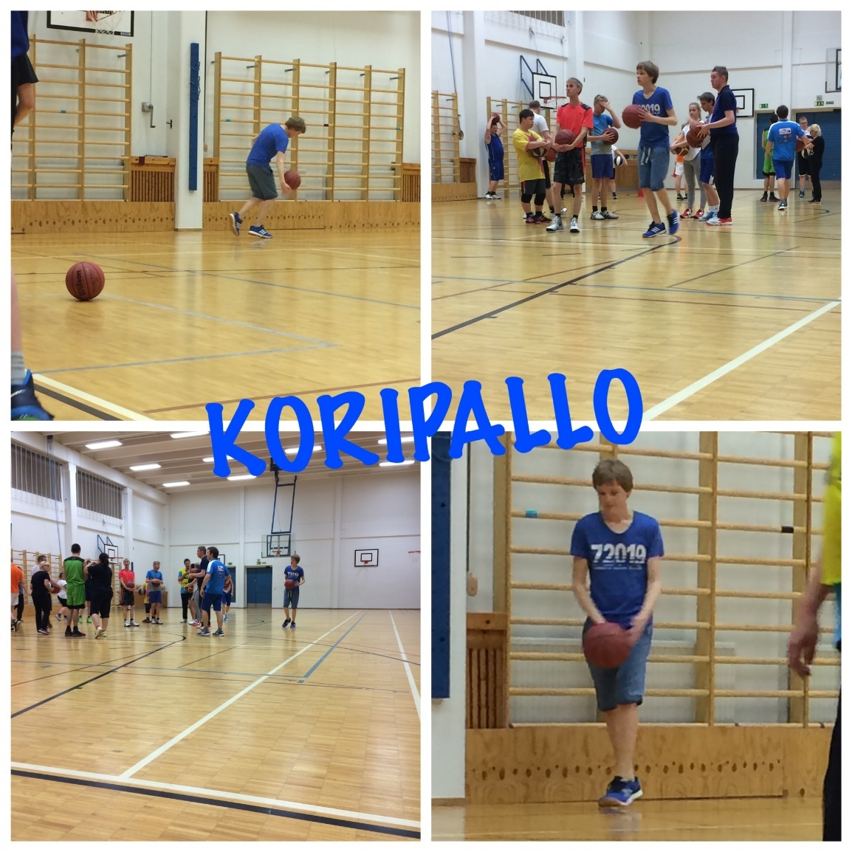
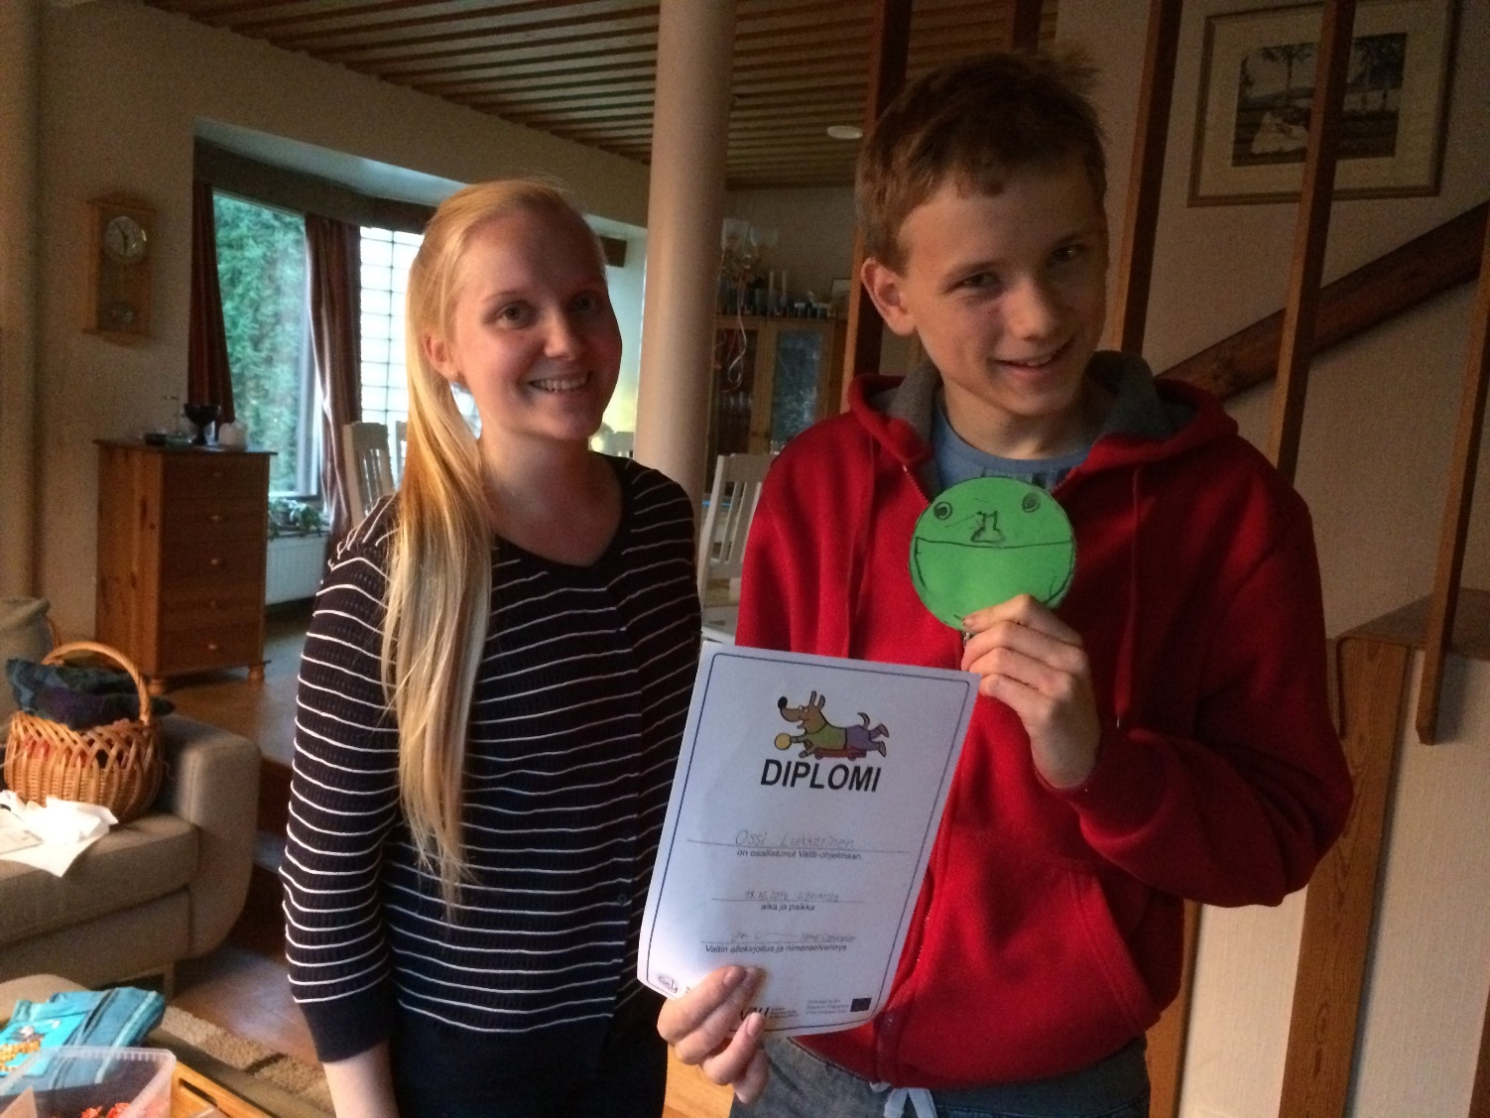
Ossi, a 14-year-old boy living in the city of Lahti has autism spectrum disorder. Now Ossi is a regular participant in a Unified basketball club.
Read more about Ossi http://www.vammaisurheilu.fi/ajankohtaista/valtti/valtti-stories

Slide 15
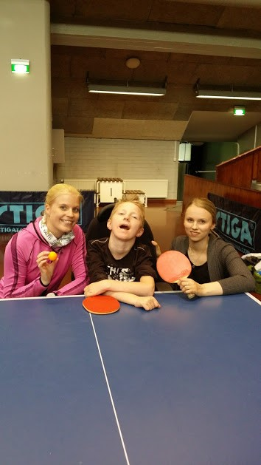
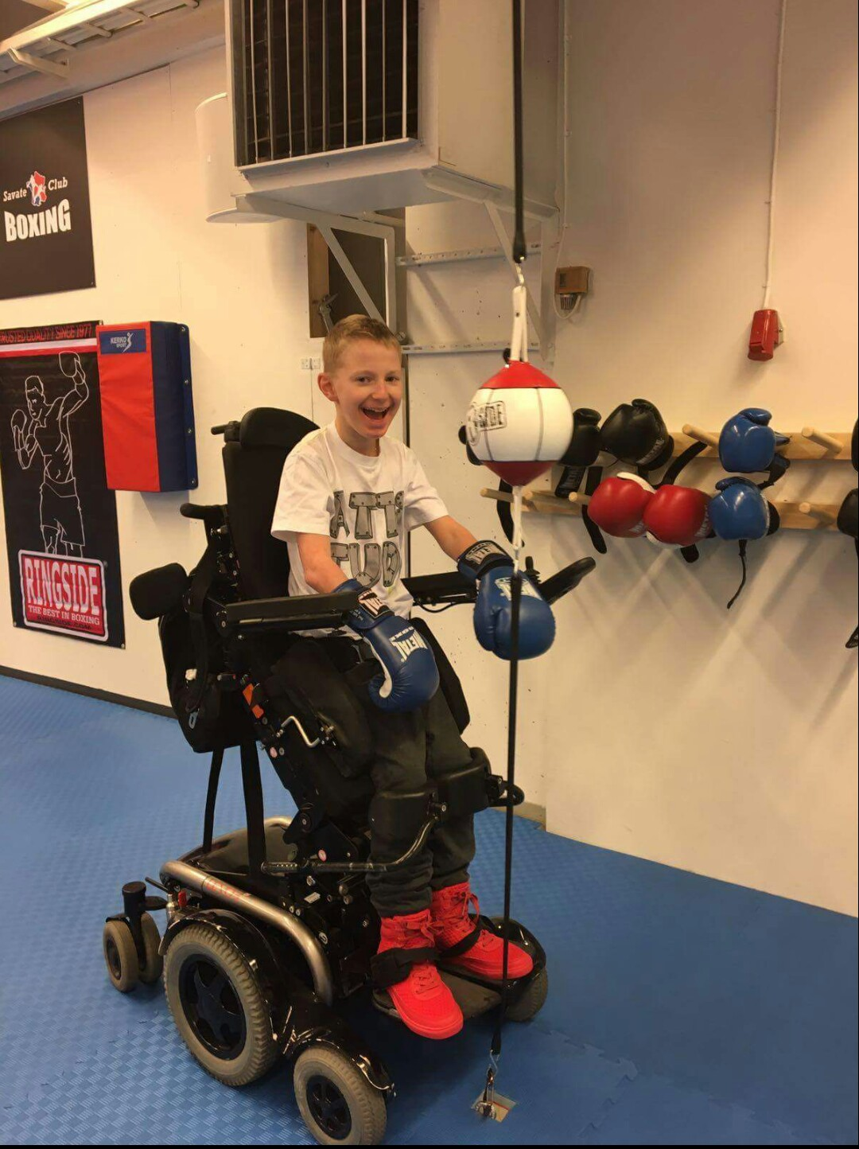
Osku, from Helsinki, tried table tennis first, but it was not that fun. The boxing club was a real success. Now Osku is a member of an ordinary savate club in Eastern Helsinki and he loves it.

Slide 16
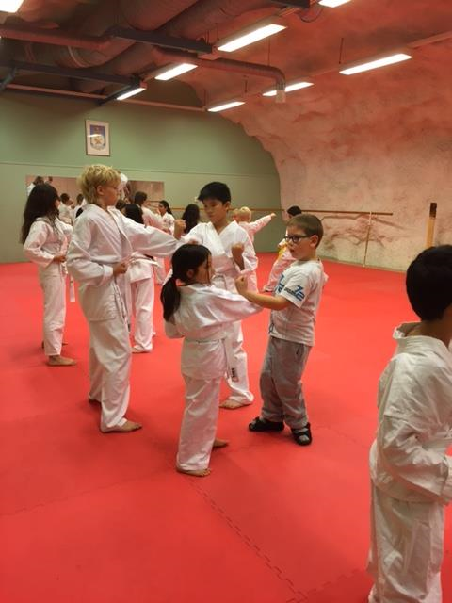
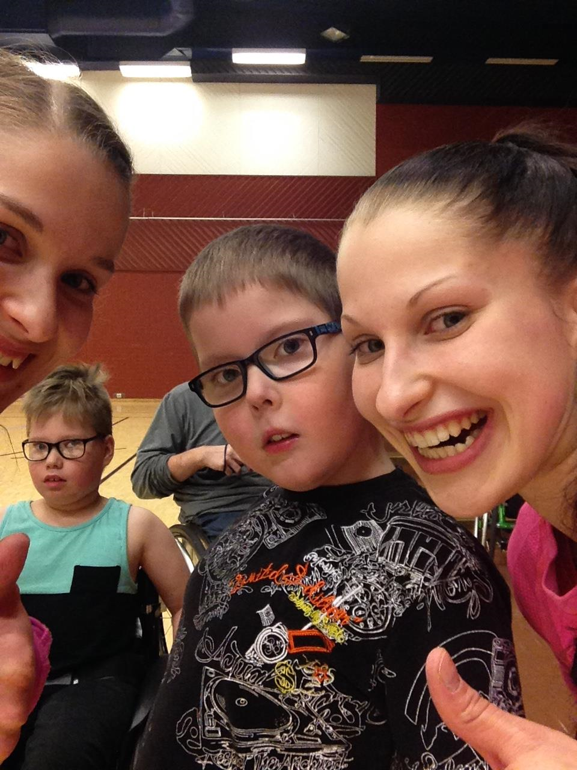
Aaro from Tampere is today a wheelchair basketball player.

Slide 17
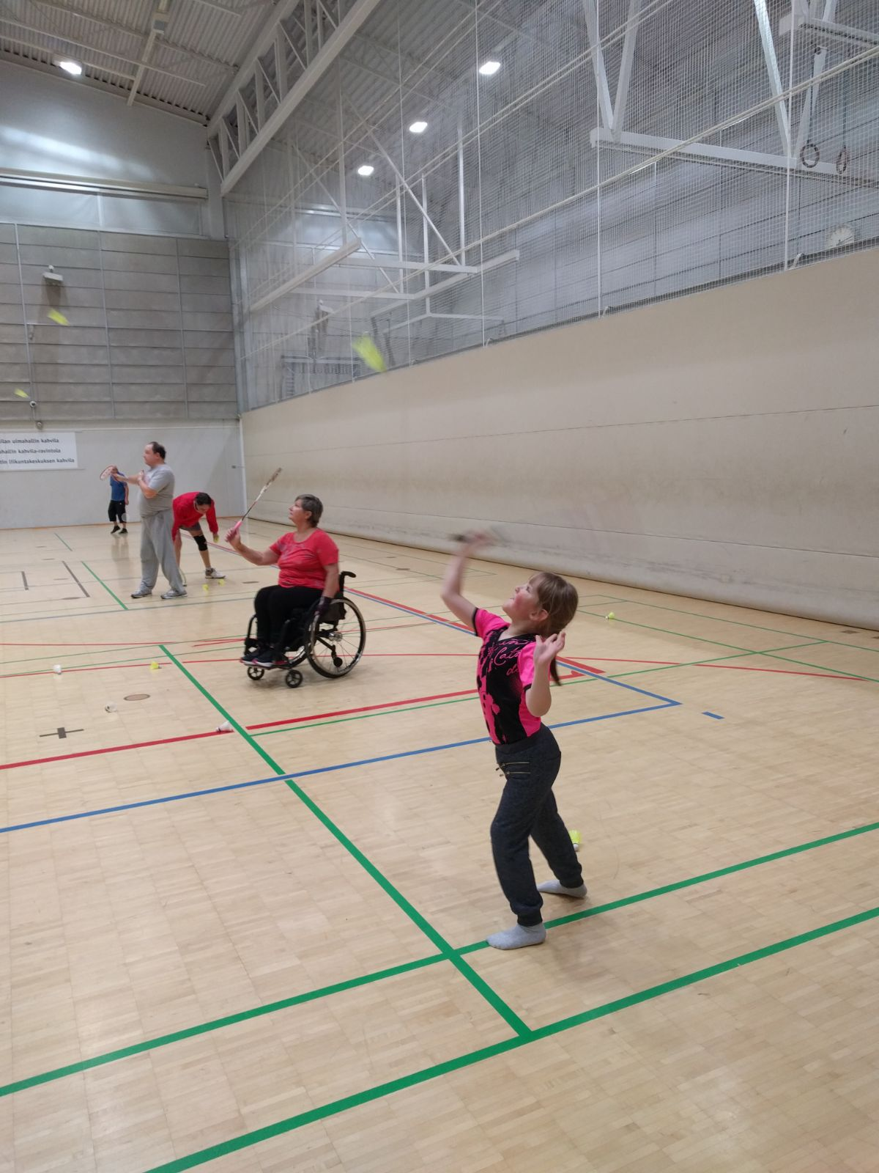
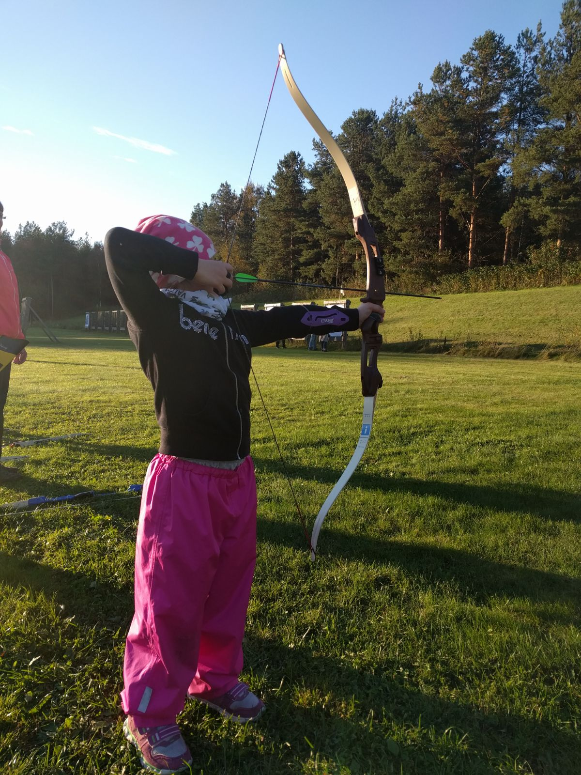
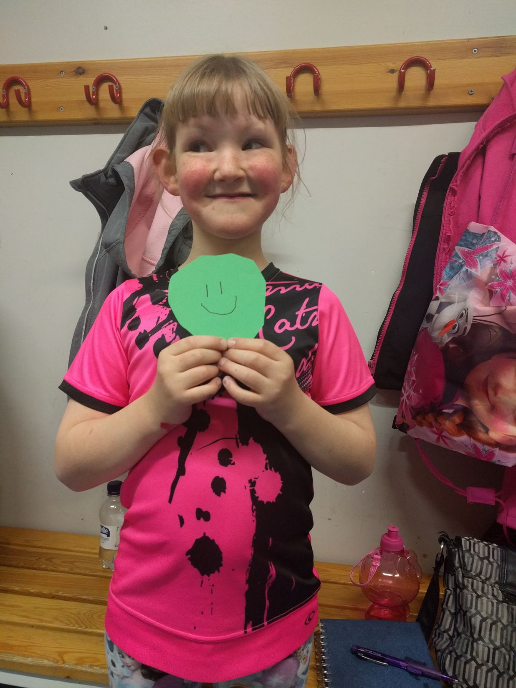
In Oulu, the whole family found a hobby along with Vera.

Slide 18
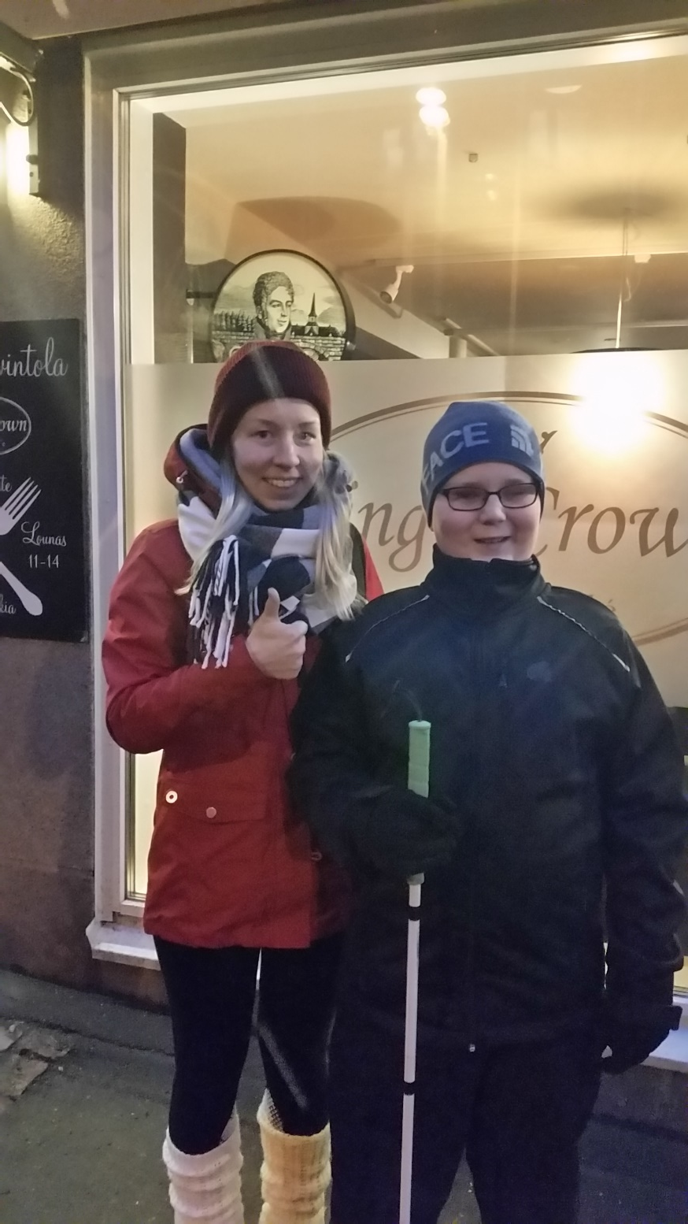
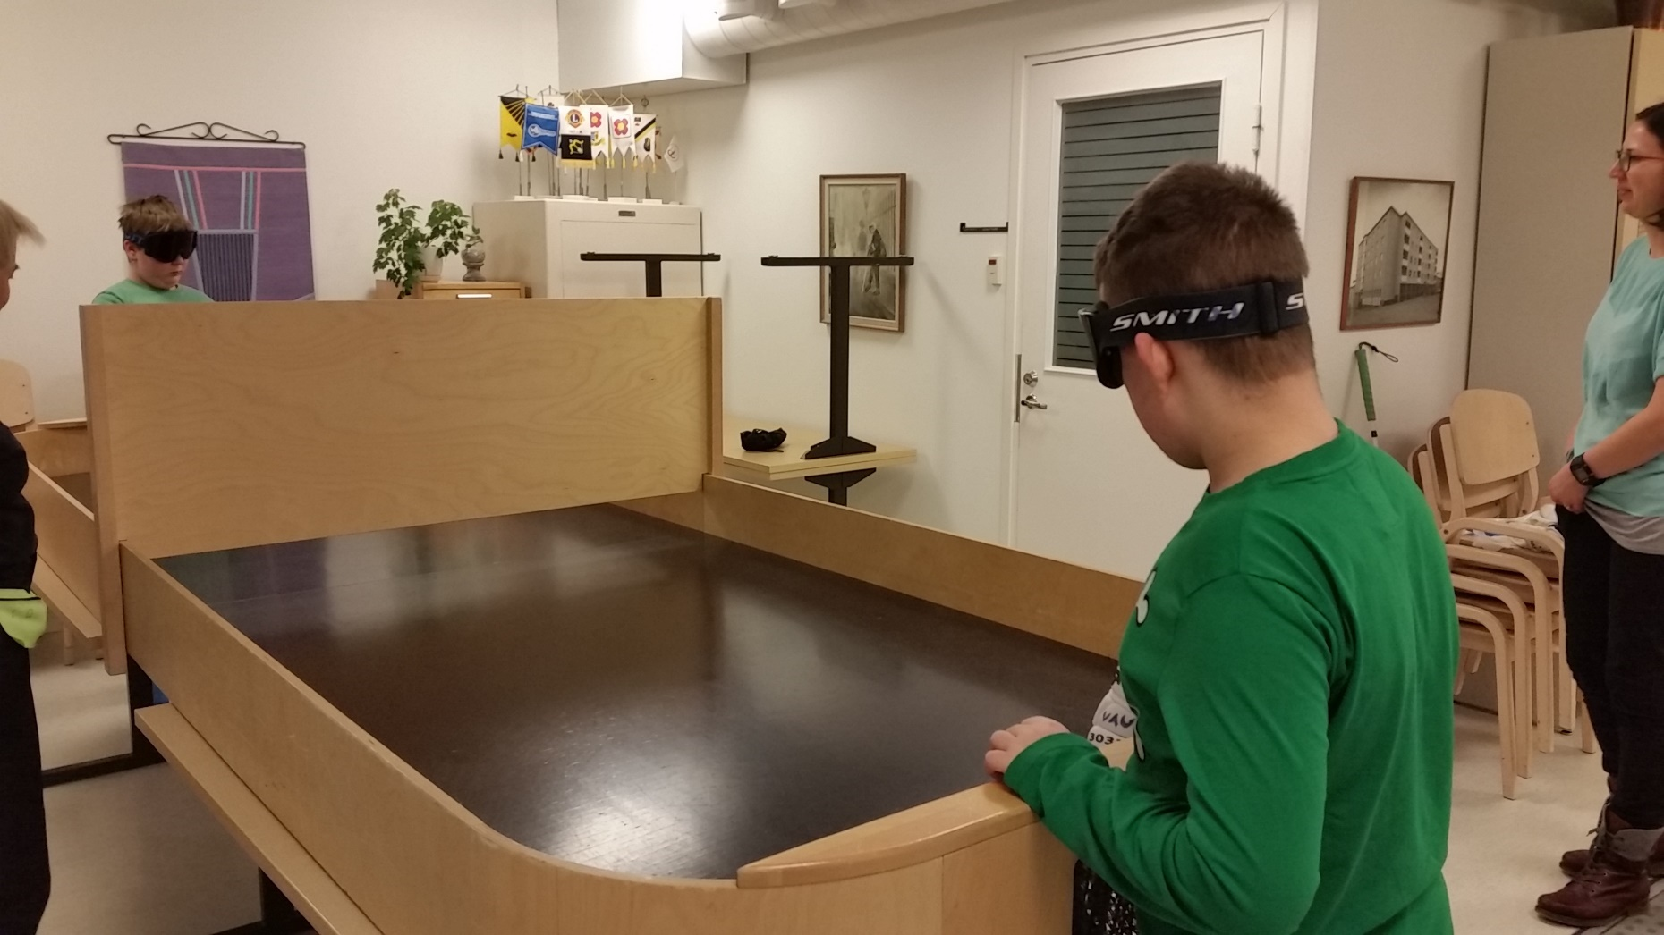
Elias from Kuopio found showdown. His Valtti Carita works today as his new leisure time personal assistant.

Slide 19
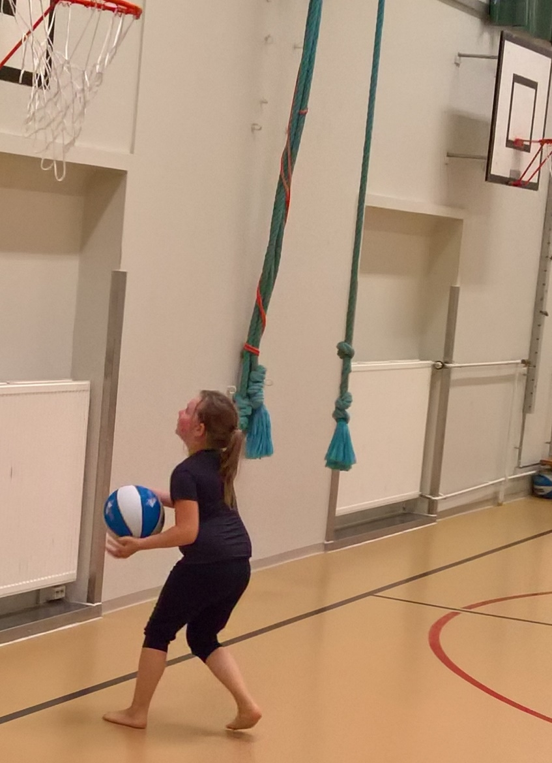
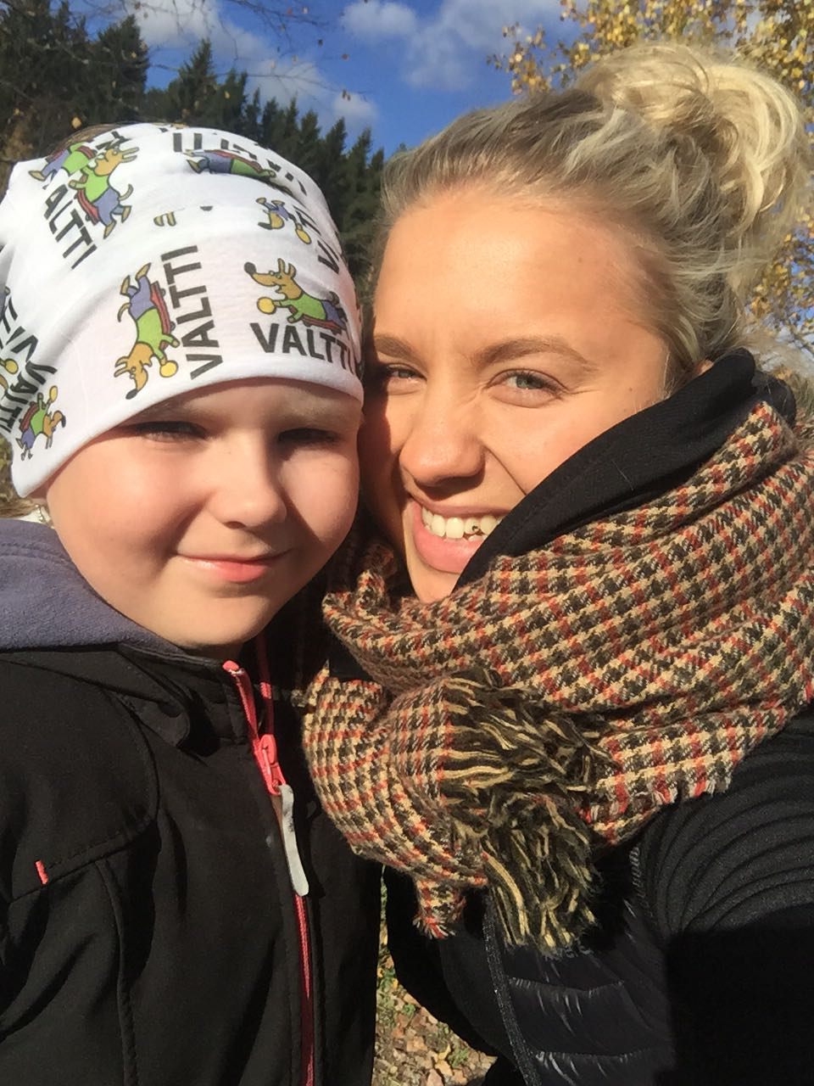
Venla, from Hollola has a visual impairment. With her Valtti Iida she tried swimming, trampolining, horseback riding, basketball, show dance, bowling and wall climbing. She didn’t become a regular participant, but gained courage and become more active.
Read more about Venla http://www.vammaisurheilu.fi/ajankohtaista/valtti/valtti-stories

Slide 20
4 x win
155 families (Heidi Skantz):
54% found a hobby.
61% become more active.
16 /(19) teachers:
Learning goals were well met & good co-operation model.
201 (∞ 250) PAPAIs:
87 % reported having learned useful profesional skills. 85 % would recommend this program to their fellow students.
12/(46) municipal APA-instructors:
Good way of marketing and developing sporting opportunities and reaching this target group, development ideas.

Slide 21

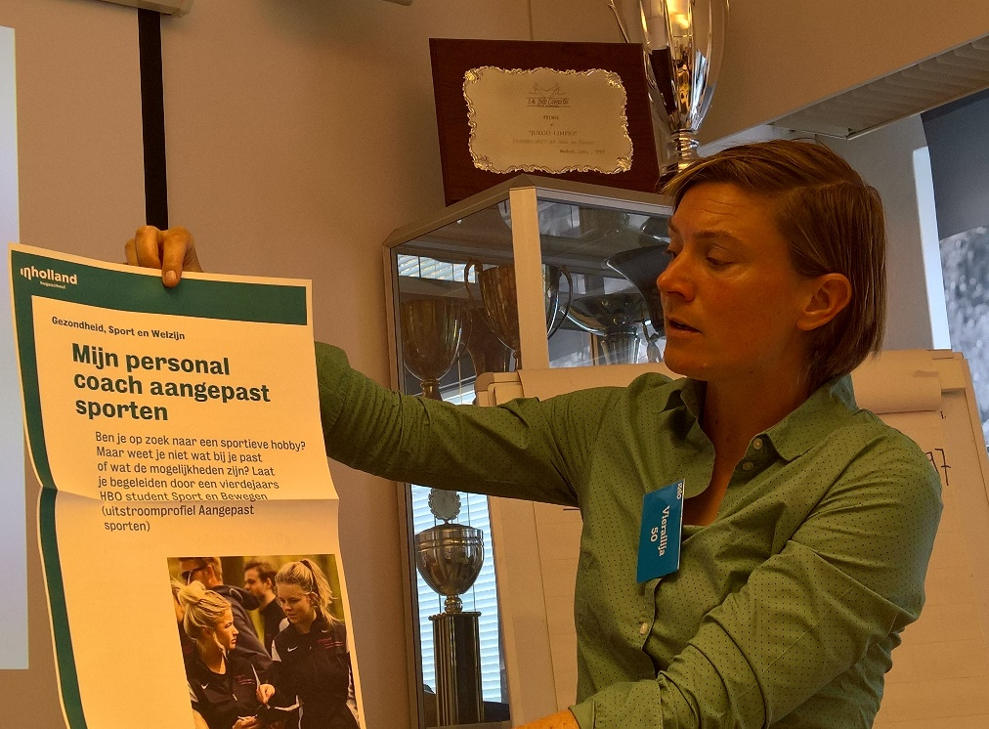
Valtti continues, and the PAPAI model is tested in the partner countries
Finnish Ministry of Education and Culture has granted financial support for VAU to continue and develop the programme for 3 more years (2017-2019).
See the SEDYwebsite for more results http://www.hva.nl/kc-bsv/gedeelde-content/contentgroep/sedy-project/results/execute-and-monitor-pilots/execute-and-monitor-pilots.html
Take a look at the Valtti-video http://www.vammaisurheilu.fi/ajankohtaista/valtti/perheille

Slide 22
For more information:
aija.saari@vammaisurheilu.fi
Resources:
Saari & Skantz (2016) The PAPAI-handbook
http://www.hva.nl/kc-bsv/gedeelde-content/contentgroep/sedy-project/results/development-of-pilots/development-of-pilots.html
Saari & Skantz (2017). Lisääntyikö liike, löytyikö harrastus? [final report, in Finnish]
http://www.vammaisurheilu.fi/images/tiedostot/ladattavat-tiedostot/valttiraportti2017.pdf
Follow:
#valtti @vammaisurheilu #papai @SEDYproject

